Slide 1

Financial Risk Management
Spring 2016
Dr. Ehud Peleg
Interest Rate Risk
1

Slide 2
Agenda
Interest Rate Risks
Bond Prices and Yields
Duration and Convexity
Term-structure risk

Slide 3
Interest Rate Risks
Portfolio Markdown due to change in levels of interest rates
A shift of rates at all maturities: duration risk
Change in relationship between maturities – yield curve moves
Cash flow mismatch between assets and liabilities: re-pricing risk
Change in spreads between different curves: basis risk
Liquidity differences
Credit spreads
Interest rate related behavioral options

Slide 4
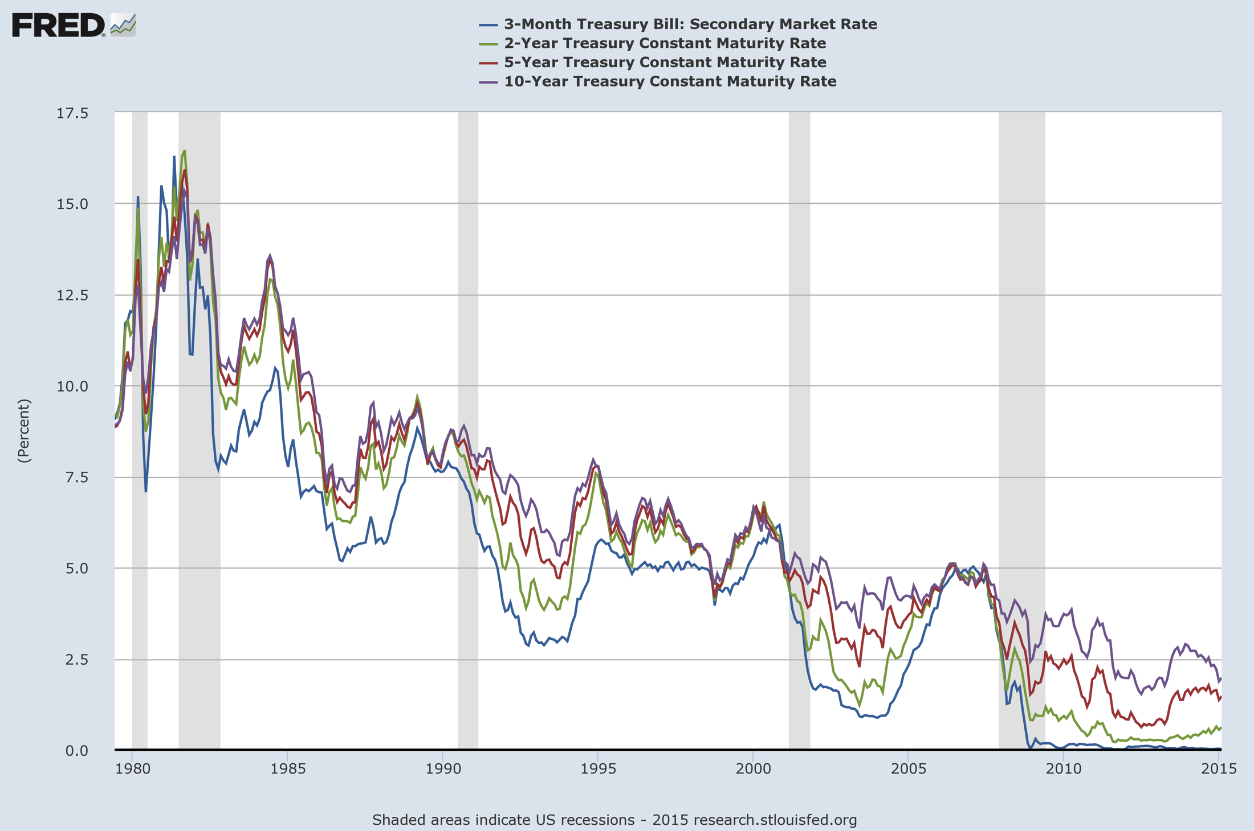

Slide 5
Orange County – Duration Risk
In 1994, Orange County lost $1.6 billion when the interest rate level suddenly increased from 3% to 5.7%
This sent the county into bankruptcy
The county’s Treasurer, Bob Citron, had bet, through a mix of structured notes and leverage, that rates would not increase in the future
The portfolio was too sensitive to changes in interest rates

Slide 6
Term Structure
The term structure of interest rates, or spot curve, or yield curve, defines the relation between the level of interest rates and their time to maturity
The term spread is the difference between long term interest rates (e.g. 10 year rate) and the short term interest rates (e.g. 3 month interest rate)
The term spread depends on many variables: expected future inflation, expected growth of the economy, agents attitude towards risk, etc.
The term structure varies over time, and may take different shapes

Slide 7
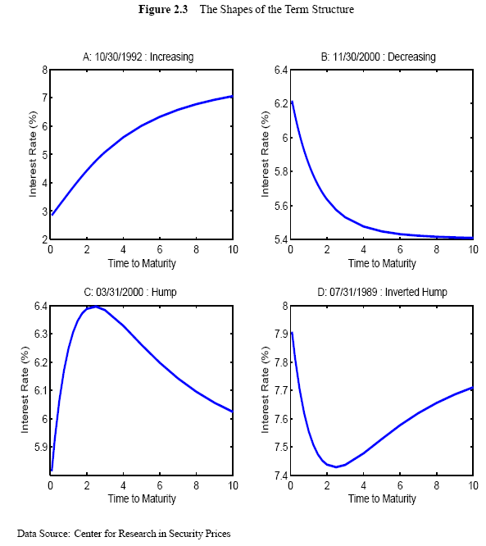
Term Structure of Rates

Slide 8
Interest Rate Mismatch – Re-pricing Risk
Savings and Loan (S&L) earned revenue from the difference between long term mortgages (assets) and short term deposits (liabilities)
Interest rates increased in late 70s and early 80s,
S&L received their fixed coupon from mortgages contracted in the past (when rates were low),
but now had to pay high interest on new deposits
This spread sent many S&L out of business

Slide 9
LTCM - Basis Risk
Long-Term Capital was trading on various, “relative value” trades
In 1997 some spreads did not converge due to credit and liquidity issues, LTCM ran out of liquidity to fund trades
Source: “Risk Management Lessons from Long Term Capital” – P. Jorion 2000

Slide 10
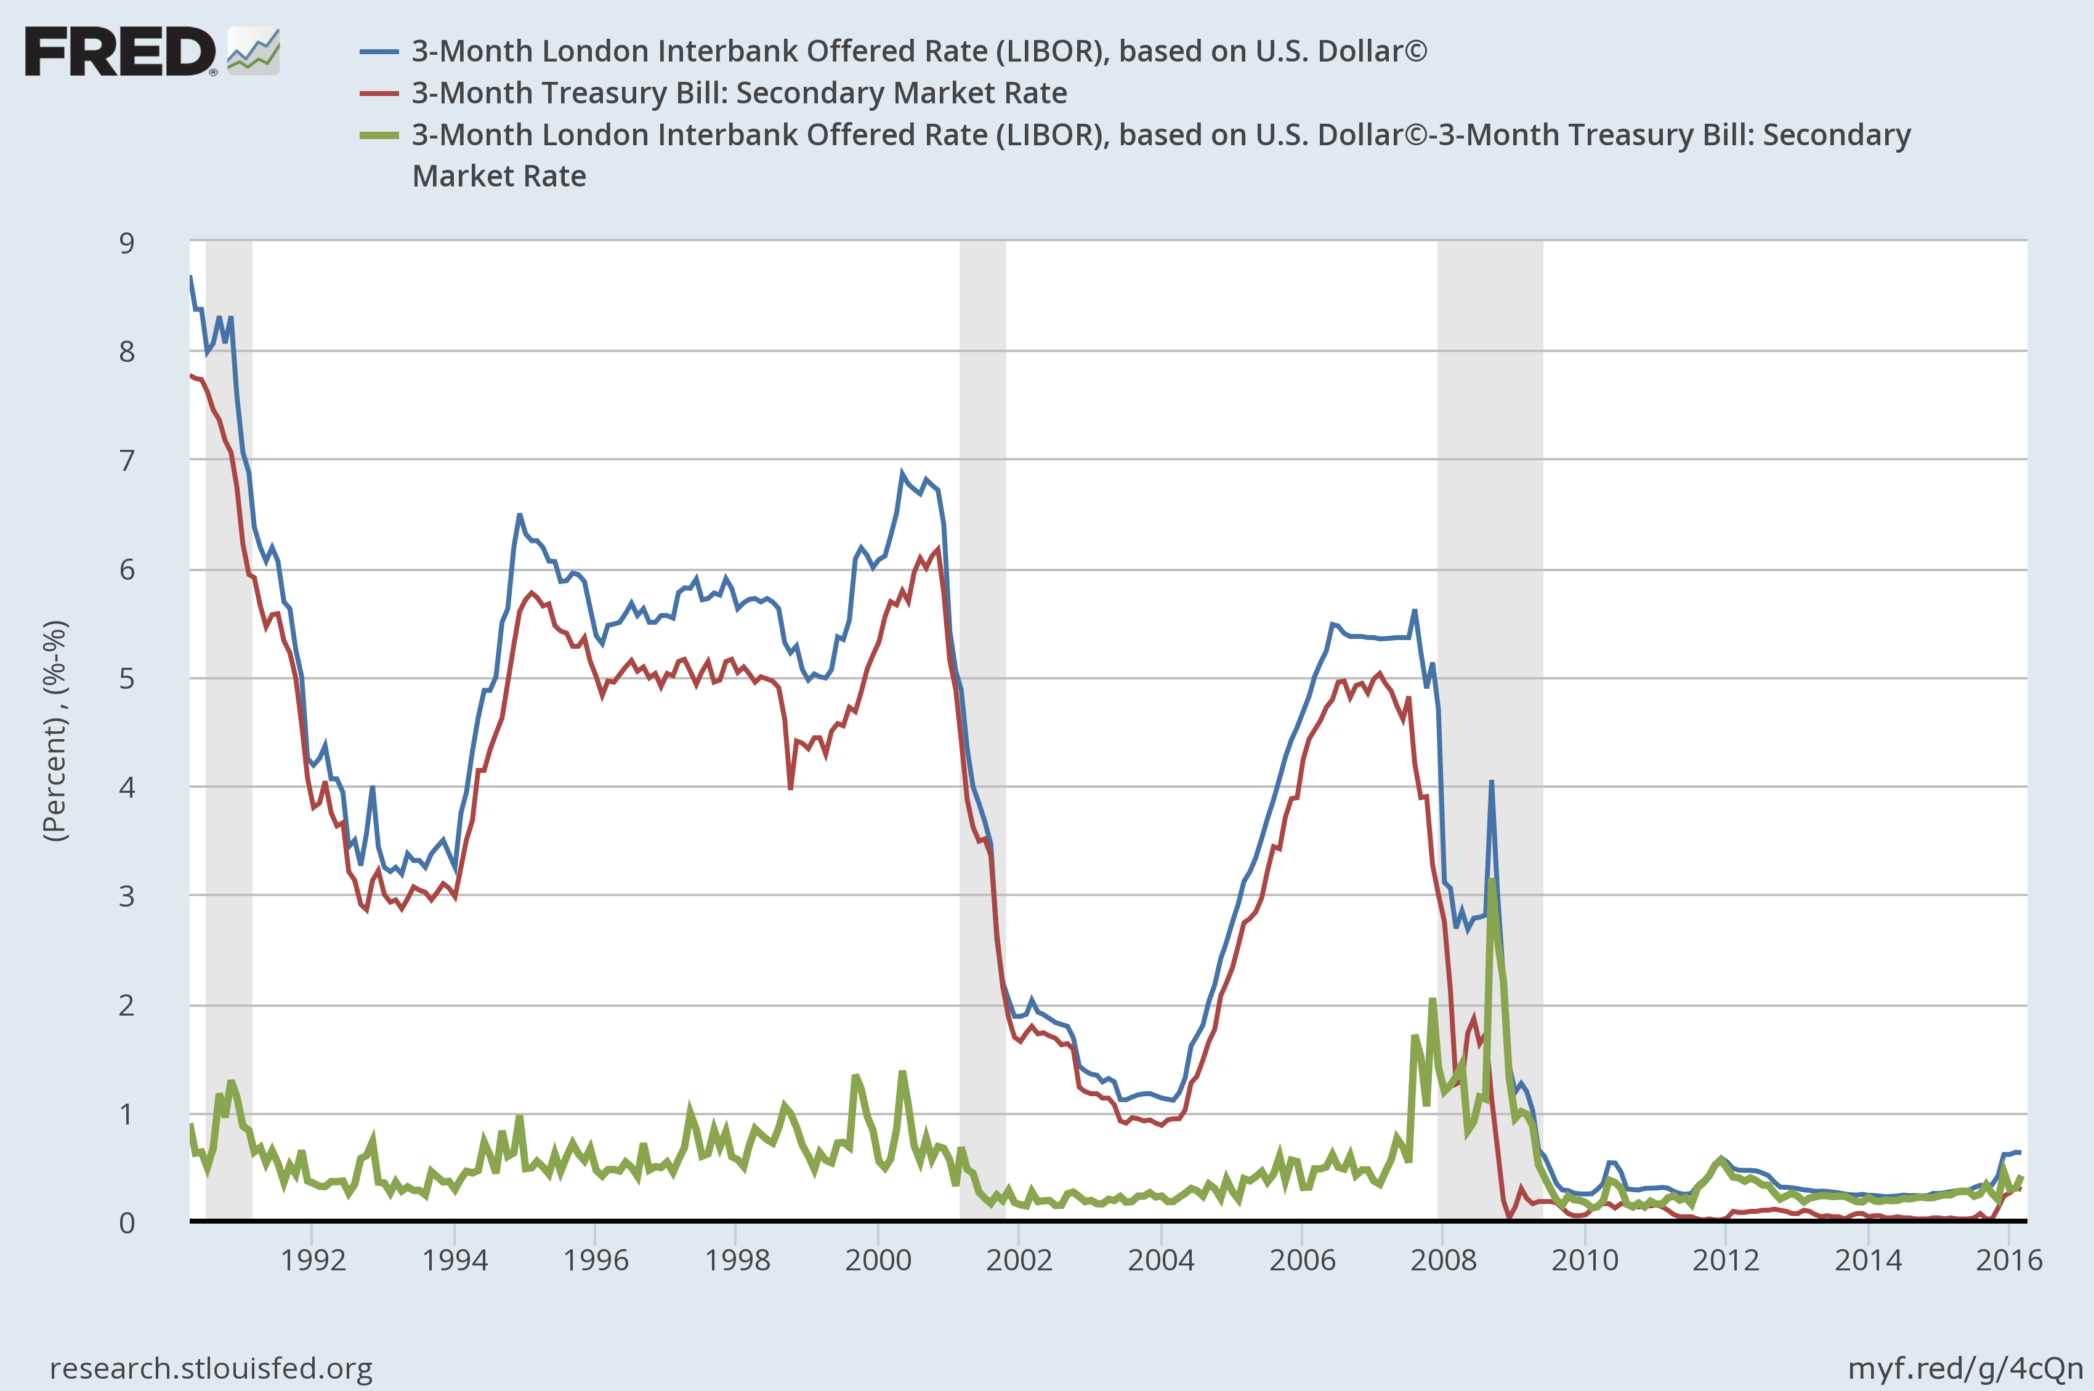
Indication of Stress

Slide 11
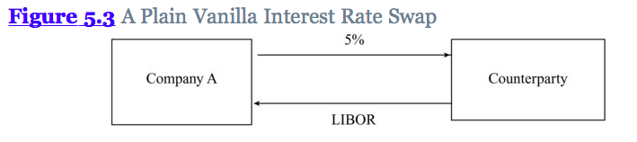
Interest Rate Swaps
Swap – an agreement to change cash flows in the future
Interest Rate Swap – an agreement to change cash flows indexed to a floating rate for a fixed rate.

Slide 12
Swap Rates
Swap rates: Long term fixed rates that are swapped for LIBOR.
LIBOR/Swap curve: Swap rates are used to extend the LIBOR curve beyond 1 year
Serve as “risk-free” rates for pricing derivatives in banks, because they reflect AA counterparty risk

Slide 13
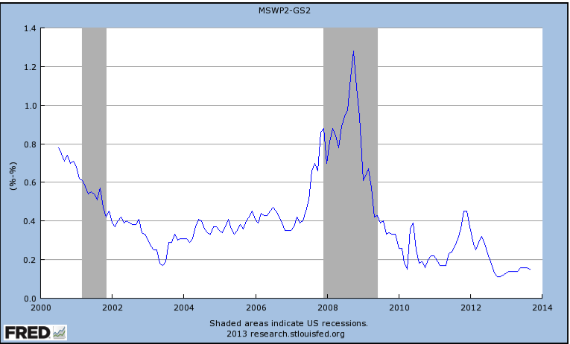
Swap Spread

Slide 14
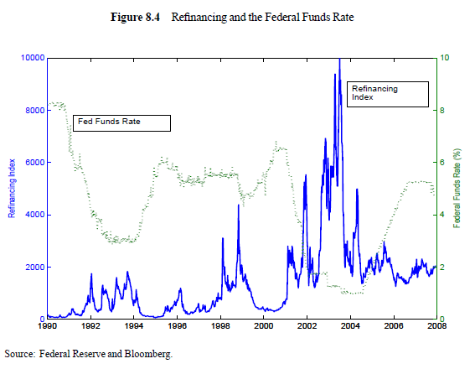
Prepayment of Mortgages in 2002-2003

Slide 15
Bond Prices
Zero-coupon bonds pay at maturity only.
Their price is the value of their Notional, or Face Value, discounted by the relevant spot-rate
Coupon bonds have periodic cash flows, including coupons and notional.
By arguments of no-arbitrage, a coupon bond Price is equal to the appropriately discounted cash flows:
or

Slide 16
Yield To Maturity
Yield to Maturity is the single rate that will set the present value of cash flows equal to current price:
The compounding interval affects the yield.
The yield can be thought of as an average of the interest rates along the different maturities.

Slide 17
Computing Yield - Example
A semi-annual 10% coupon bond with 3 years to maturity is trading at 94.213, what is the continuously compounded yield on the bond?
The bond has six more coupon payments (of $5) and a principal payment in 3 years.
Use Solver to find y:

Slide 18
Duration
Duration of a bond that provides cash flow cf_{i} at time t_{i} is:
Since:
An approximate relationship holds:

Slide 19
Calculation of Duration for a 3-year bond paying a s.a. coupon 10%. Bond yield=12%.
Time (yrs) | Cash Flow ($) | PV ($) | Weight | Time × Weight
0.5 | 5 | 4.709 | 0.050 | 0.025
1.0 | 5 | 4.435 | 0.047 | 0.047
1.5 | 5 | 4.176 | 0.044 | 0.066
2.0 | 5 | 3.933 | 0.042 | 0.083
2.5 | 5 | 3.704 | 0.039 | 0.098
3.0 | 105 | 73.256 | 0.778 | 2.333
Total |  | 94.21 | 1 | 2.653

Slide 20
Using Duration to Estimate Change in Bond Price
What will be the change in the bond’s price if the yield goes up by 10 basis points?
Verify result by repricing the bond with y=12.1%

Slide 21
Modified Duration
When the yield y is expressed with compounding m times per year
The expression
is referred to as the “modified duration”

Slide 22
Properties of Duration
Duration is a measure of average time to cash flows.
Duration increases with maturity. The further out the maturity the more sensitive is the bond to yield changes.
Duration is lower for higher coupon bond. The higher the coupons, the larger are the intermediate coupons relative to the last one. Thus the average time of payments gets closer to today.
Duration is equal to Maturity for zero coupon bonds.

Slide 23
Convexity
The convexity of a bond is defined as:

Slide 24
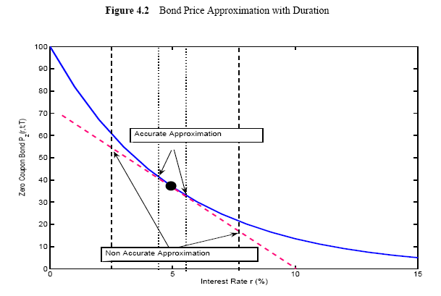

Slide 25
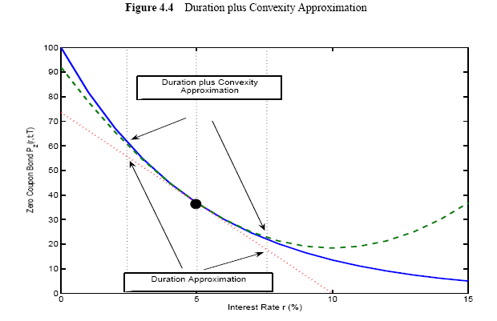

Slide 26
Portfolios
Duration and convexity can be defined similarly for portfolios of bonds and other interest-rate dependent securities
The duration of a portfolio is the weighted average of the durations of the components of the portfolio. Similarly for convexity.

Slide 27
Other Measures
Dollar Duration: Product of the portfolio value and its duration
The change in dollar value of the bond for a change in yield
The delta of the bond with respect to the yield
DV01 – Impact of 1 bp parallel shift in all rates
Dollar duration * 0.01
Dollar Convexity: Product of convexity and value of the portfolio

Slide 28
Partial Duration
Partial Duration − effect on a portfolio of a change to just one point on the zero curve
Partial Dollar Duration – The dollar change in portfolio value due to change in one rate.

Slide 29
Partial Duration
Time (yrs) | Cash Flow ($) | Rate | PV ($) of FV=100 | Weight | Time *Weight | Time * Weight *Price
 |  |  |  |  | Duration | Dollar Duration
0.5 | 5 | 12% | 4.71 | 0.050 | 0.025 | 2.35
1 | 5 | 12% | 4.43 | 0.047 | 0.047 | 4.43
1.5 | 5 | 12% | 4.18 | 0.044 | 0.066 | 6.27
2 | 5 | 12% | 3.93 | 0.042 | 0.083 | 7.87
2.5 | 5 | 12% | 3.70 | 0.039 | 0.098 | 9.26
3 | 105 | 12% | 73.26 | 0.778 | 2.333 | 219.77
Total |  |  | 94.21 | 1 | 2.65 | 249.948
What would happen to the bond’s price if 3-year rate went up by 1%?

Slide 30
Partial Durations and Yield Curve Changes
Any yield curve change can be defined in terms of changes to individual points on the yield curve
For example, a rotation can be defined by:
Maturity (yrs) | 1 | 2 | 3 | 4 | 5 | 7 | 10
Shock | -3ε | -2ε | -ε | 0 | +ε | +3ε | +6ε

Slide 31
Impact of Rotation
Suppose we have a portfolio with the following partial durations:
The impact of the rotation on the proportional change in value of the portfolio:
Maturity yrs | 1 | 2 | 3 | 4 | 5 | 7 | 10 | Total
Partial Duration | 0.2 | 0.6 | 0.9 | 1.6 | 2.0 | −2.1 | −3.0 | 0.2

Slide 32
Portfolio Sensitivity to Rates
An investor has the following position
Long FV=$1,000 of 1-year zero coupon
Short FV = $4,475 of 5-years zero coupon
Long FV=$3,000 of 10-years zero coupon
Interest Rates are 4%, 5%, 6% continuously compounded for 1-, 5-, 10- yrs respectively
Compute the change in portfolio value for 1bp increase in each of the rates.
Is the portfolio sensitive to a parallel shift in interest rate?
Is the portfolio sensitive to flattening of the curve, i.e. 1bp increase in 1-year and 1bp decrease in 10-yr?

Slide 33
Portfolio Sensitivity to Rates (cont)
Time (yrs) | Notional ($) | PV of CF ($) | Dollar Duration (DD)= PV(CF)*Time |  | a. Change in Value = −DD*0.0001
1 | 1000 | 960.79 | 960.8 |  | -0.096
5 | -4475 | -3485.13 | -17,425.7 |  | 1.742
10 | 3000 | 1646.43 | 16,464.3 |  | -1.646
b. Parallel Shift of rates: Total change in price = -0.096+1.742-1.646= 0
c. Increase in 1-year and decrease in 10-year = -0.096+1.646 = 1.550
Portfolio will increase in value if curve flattens

Slide 34
Principal Components Analysis
Daily changes in the different maturities are correlated.
Instead of using so many rates it makes sense to use only 2-3 factors.
Principal Component Analysis is a method to summarize daily movements using the correlation matrix between the different rates.
The factors generated are by design independent of each other.

Slide 35
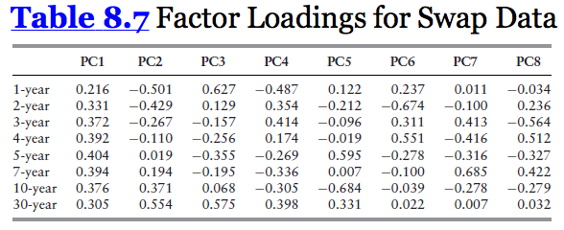

Slide 36

Factor Scores and Variances
The 8 equations imply that the daily changes in the 8 interest rates can be expressed as daily changes in the factors.
These are called daily factor scores.
We can look at the standard deviation of the factor scores to see how significant is each one:

Slide 37
The Three Factors
Parallel Shift
Twist
Bowing

Slide 38
Three Factors Explain Most Interest Rate Moves
The total variance is the sum of factor score variances:
The first factor, parallel shift, explains 90.9% of variance:
The second factor, twist, explains 6.8% of variance
The third factor, bowing, explains 1.3% of variance

Slide 39
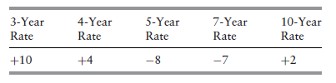
Sensitivity to Changes in Yield Curve using Principal Components
Suppose a portfolio has the following sensitivities to 1-basis-point rate moves, in $ millions:
How sensitive is the portfolio to each one of the factors?
PC1:
PC2:
To what risk is it exposed the most?
PC1: -0.05 * 17.55 = -0.88
PC2: -3.87 * 4.77 = -18.46

Slide 40
Thank You

